Slide 1
ESS Manual - MANAGERS
Leave

Slide 2
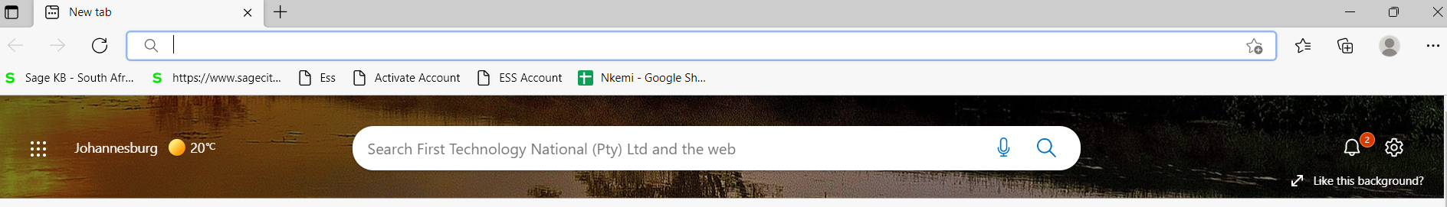
NB: Use the correct URL or ESS address
https://ess.firsttech.co.za/
Do not google the ESS address
Check old ESS emails or email Nkemelengm@firsttech.co.za for assistance or reach out to your Human Resources Payroll Department
Best to save the address on your PC
LOGIN

Slide 3
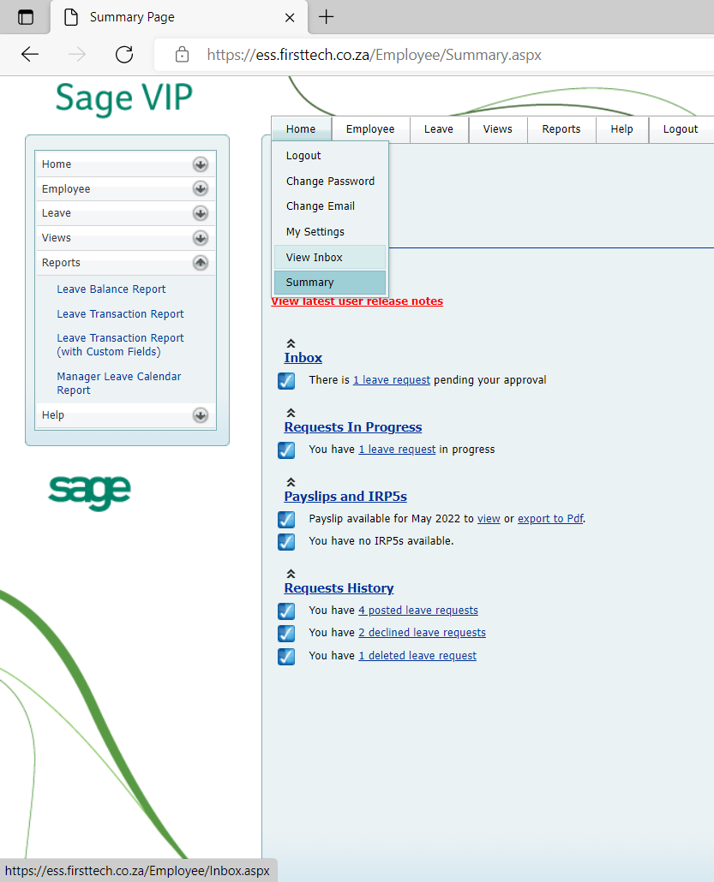
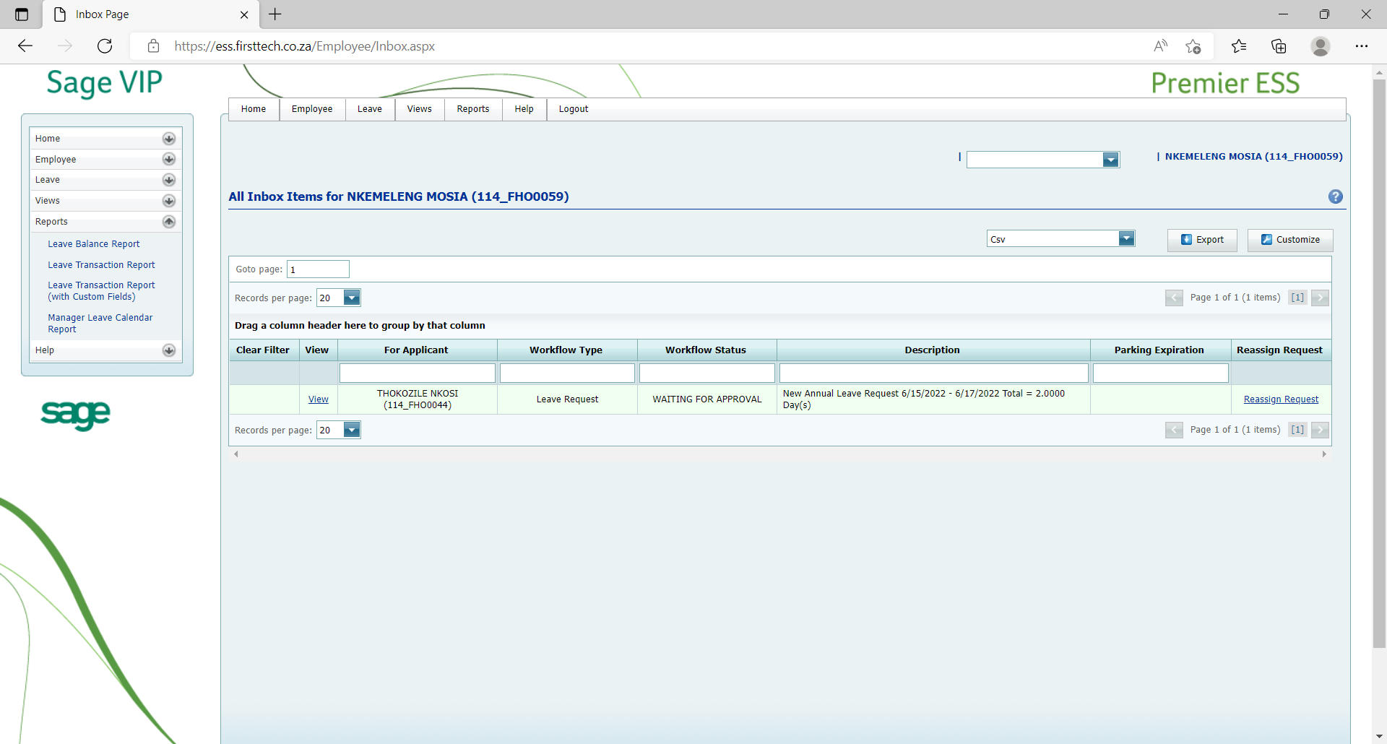
LEAVE MANAGER / APPROVER - INBOX
On your home page, at the bottom, you will find “Requests History” and how many posted leave requests you have that must be approved.
All the transactions awaiting approval will be displayed.
Click on “view”

Slide 4
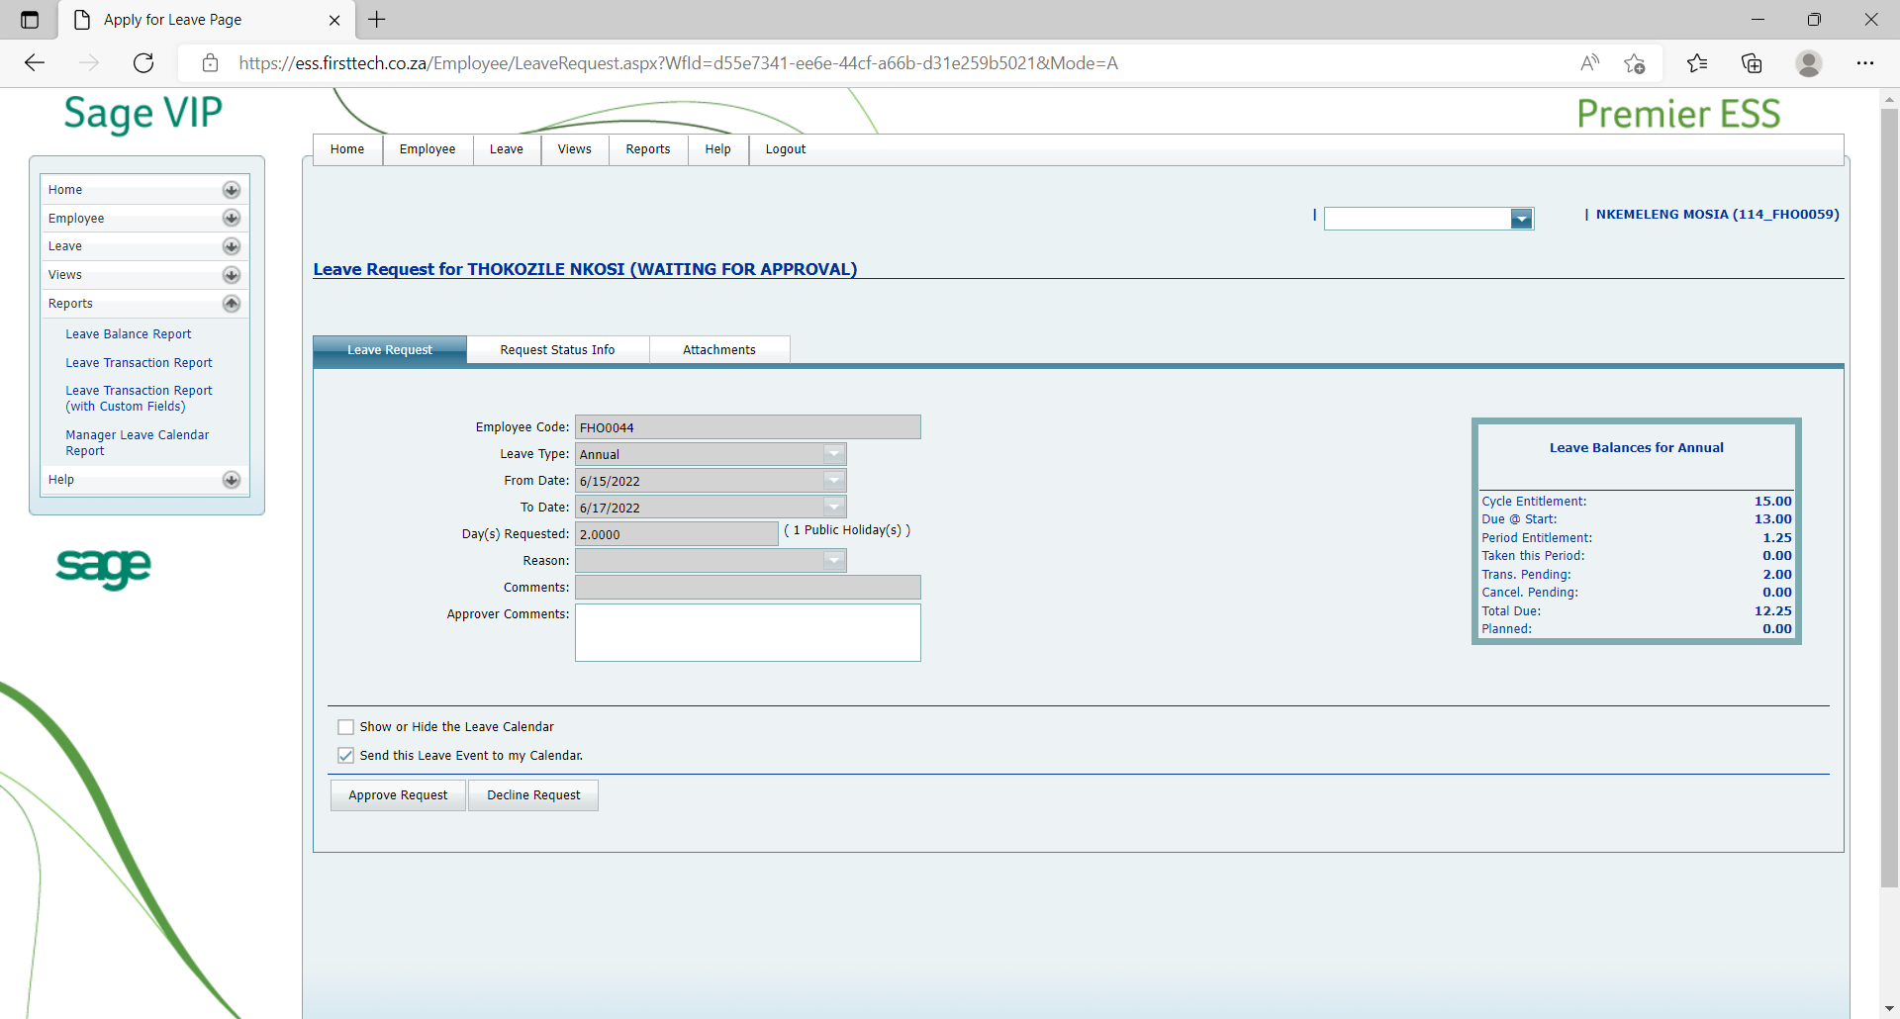
CONTINUE:
LEAVE MANAGER / APPROVER - INBOX
The Leave balance and, if necessary, attachments can be found.
Make sure to include notes if the approval is a special case.
Should you decline leave, make sure to communicate the reasons to your employee afterwards as a form of respect

Slide 5
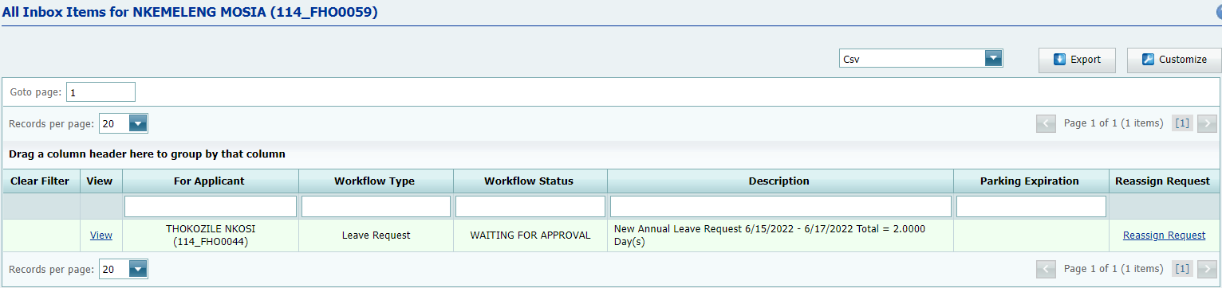
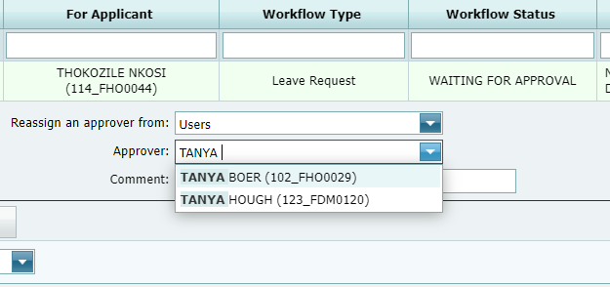
CONTINUE:
LEAVE MANAGER / APPROVER - INBOX
Reassign leave request

Slide 6
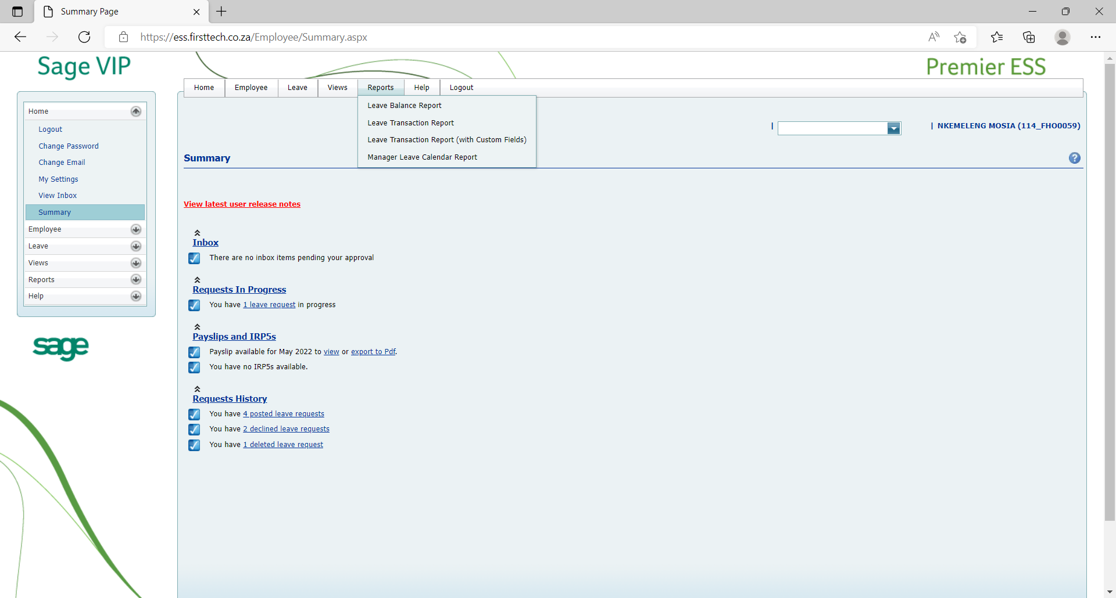
LEAVE MANAGER / APPROVER - REPORTS
Leave approver has additional Reports Tab

Slide 7
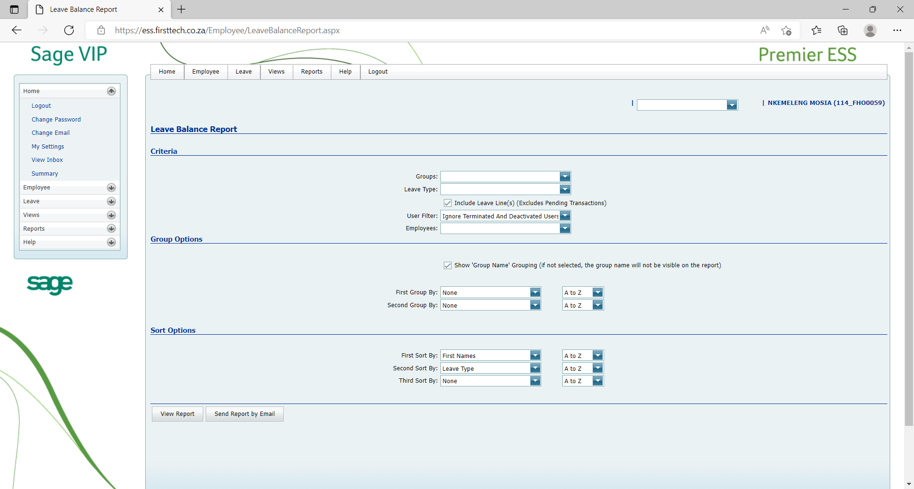
LEAVE BALANCE REPORTS
Allows viewing of leave balances for your reports.

Slide 8
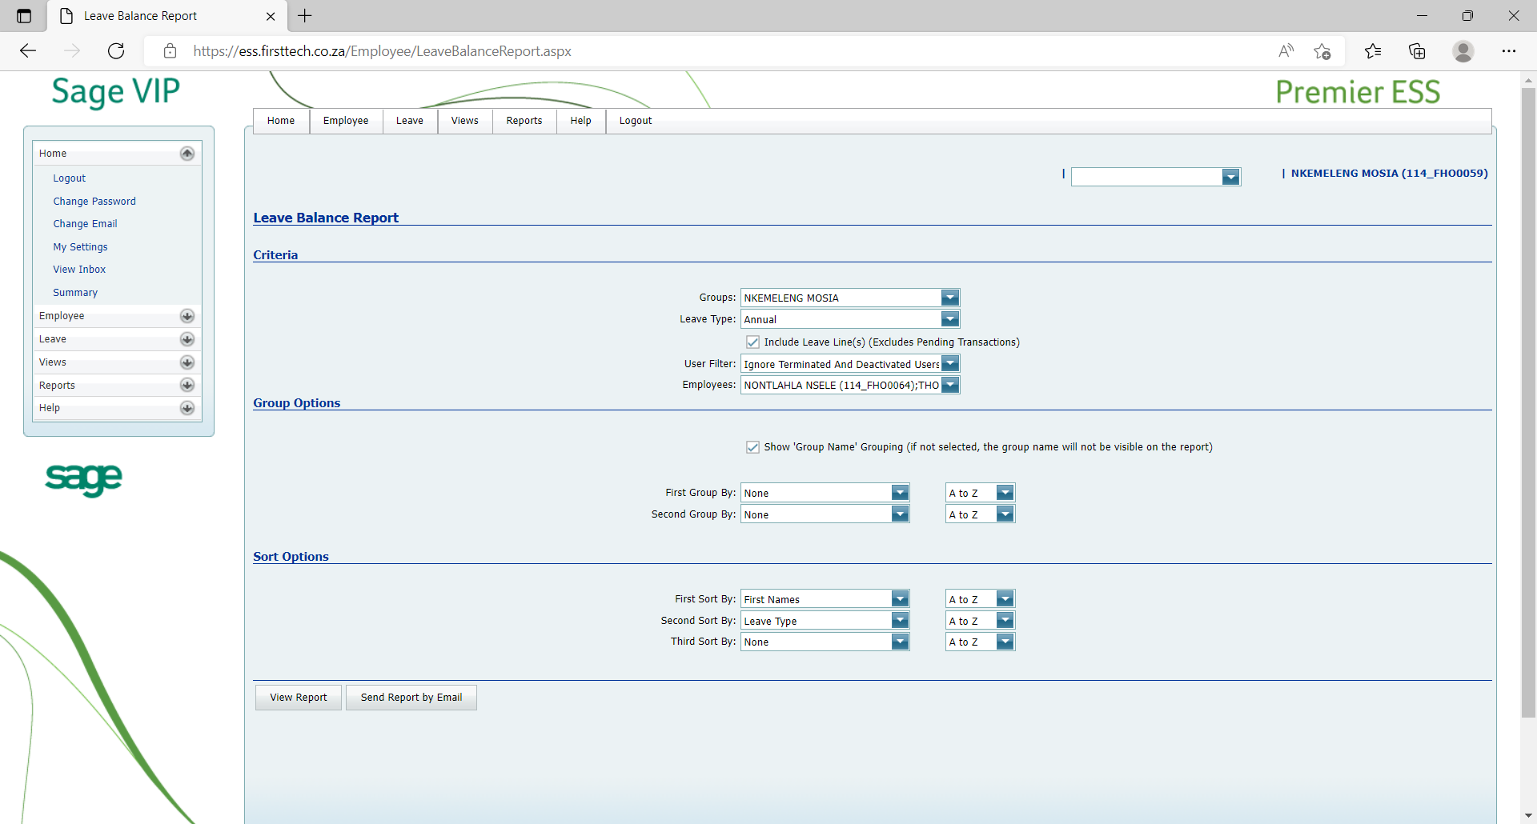

CONTINUE:
LEAVE BALANCE REPORTS
Complete the fields as required
Option to Filer, group and sort the report

Slide 9
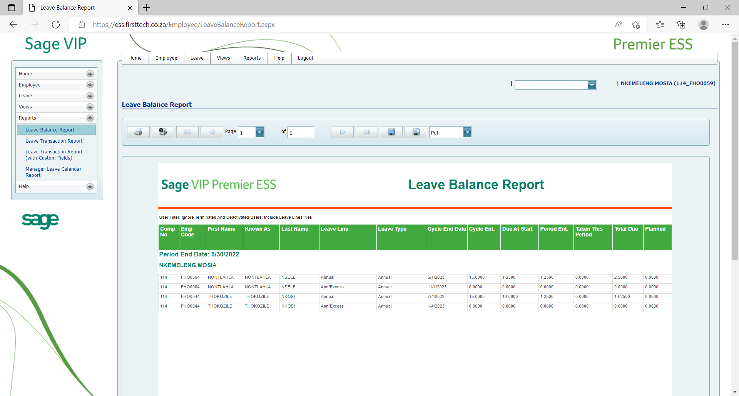
CONTINUE:
LEAVE BALANCE REPORTS example

Slide 10
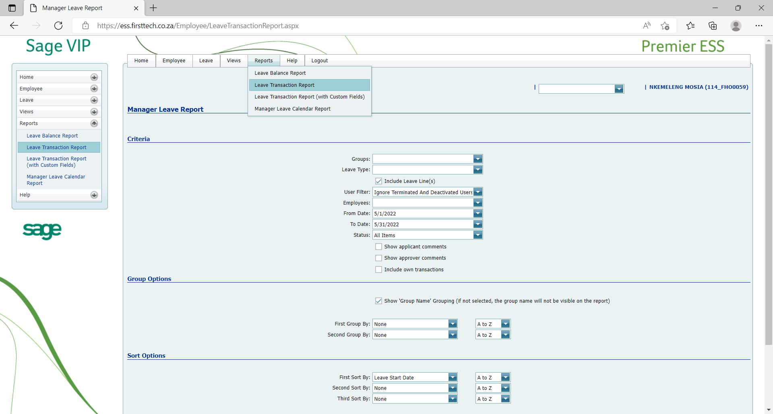
LEAVE TRANSACTION REPORTS
Allows viewing of leave transactions for your reports

Slide 11
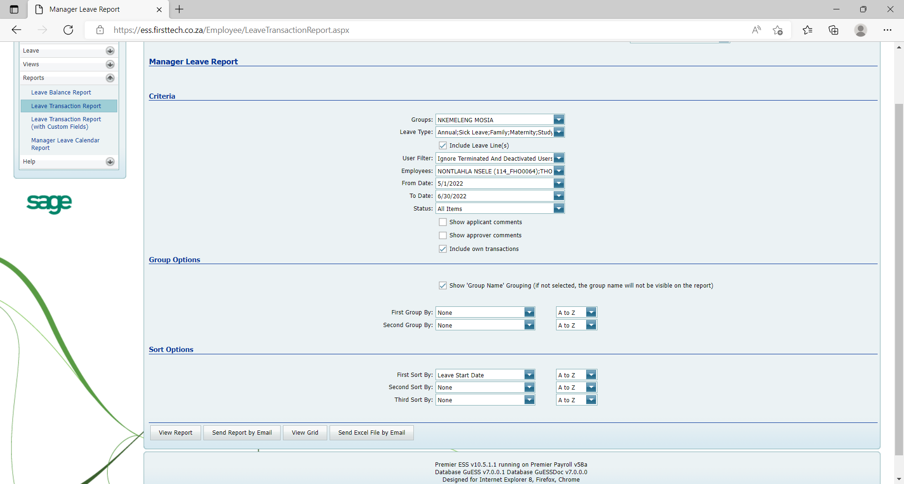

CONTINUE:
LEAVE TRANSACTION REPORTS
Complete the fields as required
Option to Filer, group and sort the report
Option to include own transactions

Slide 12
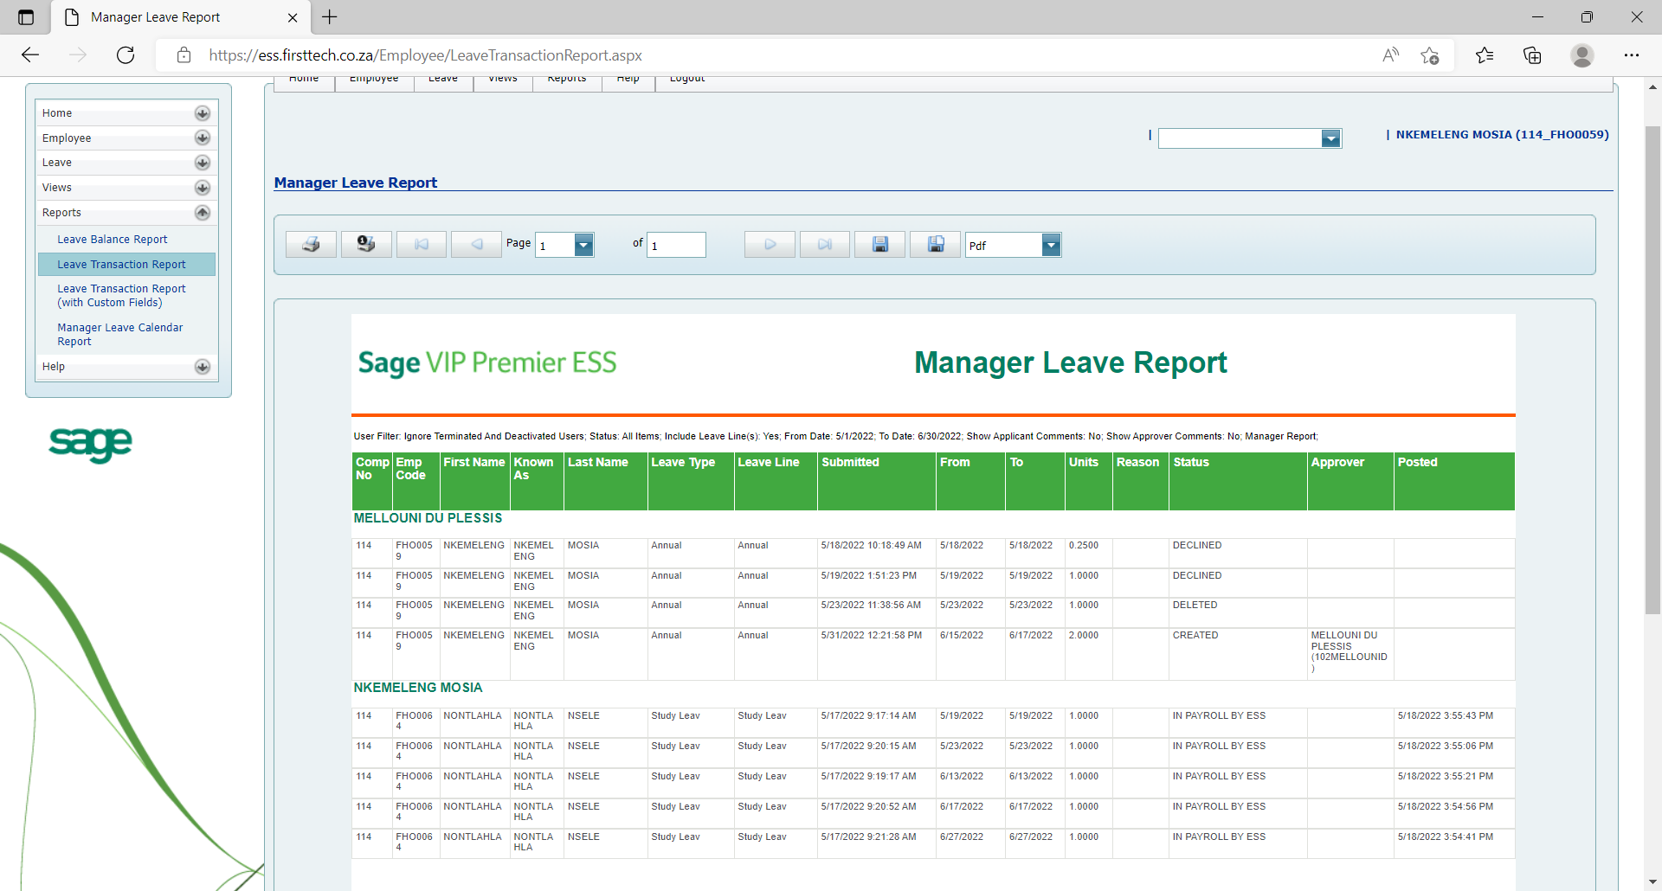
CONTINUE:
LEAVE TRANSACTION REPORTS example

Slide 13
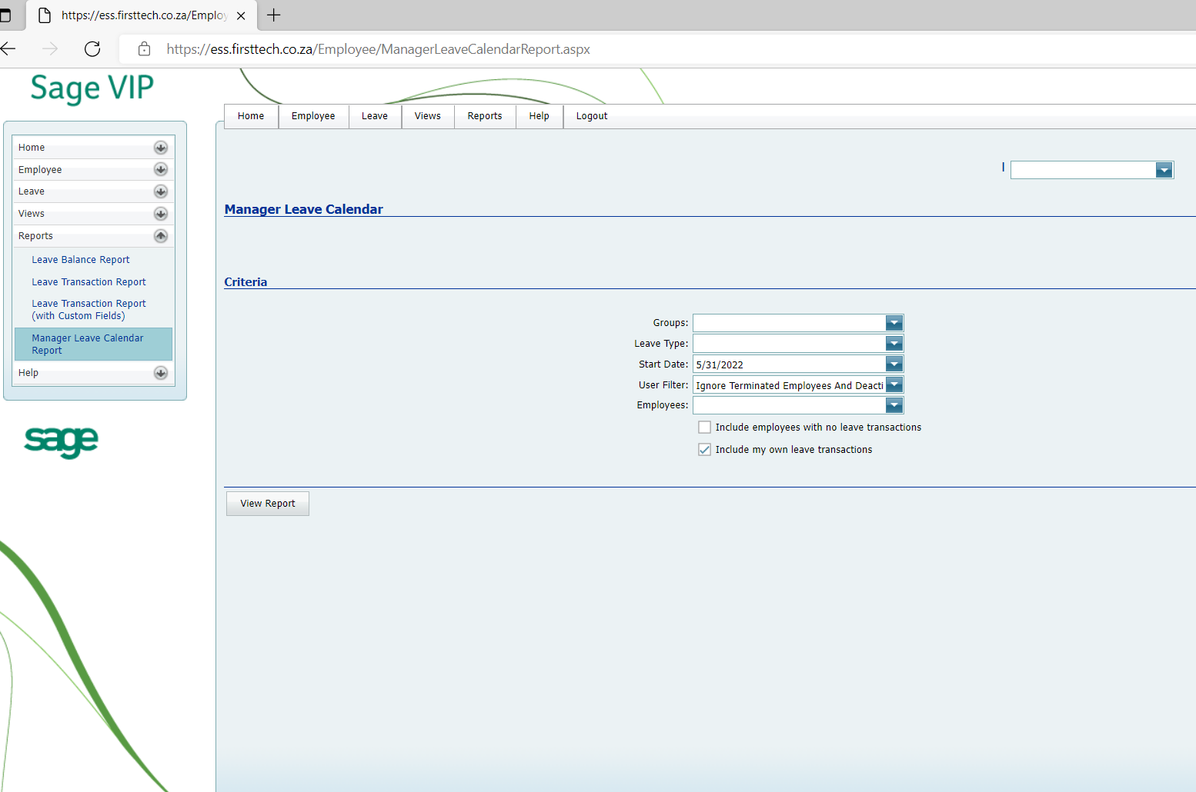
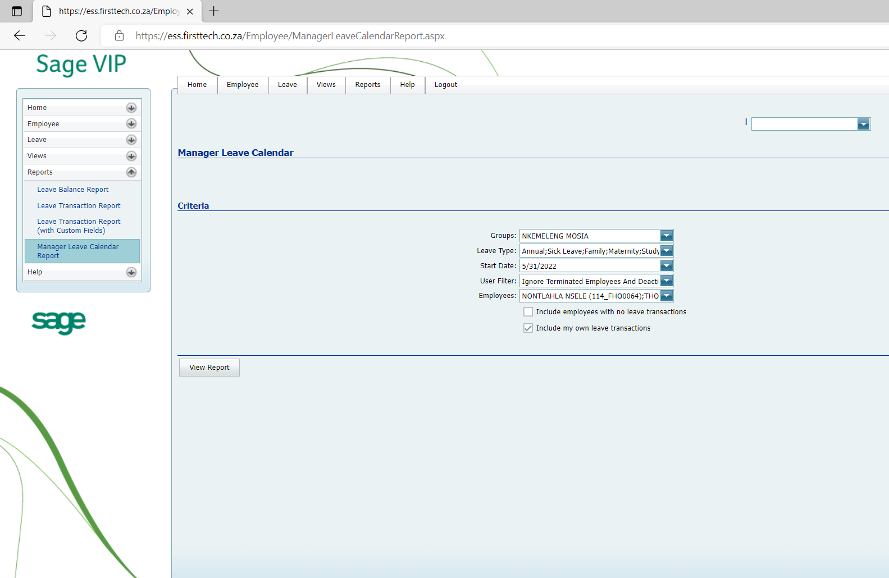
MANAGER LEAVE CALENDAR
“Leave Calendar” tab shows all the leave transactions as a picture
Transaction Detail tab shows all the leave transactions in more detail.

Slide 14
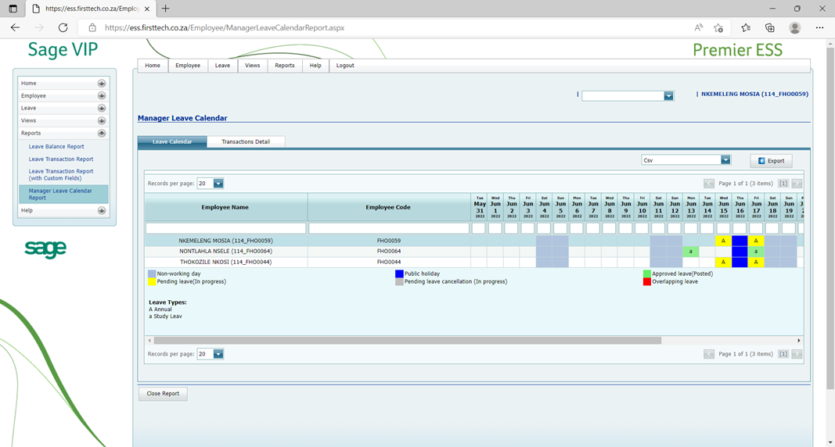
CONTINUE:
MANAGER LEAVE CALENDAR example

Slide 15
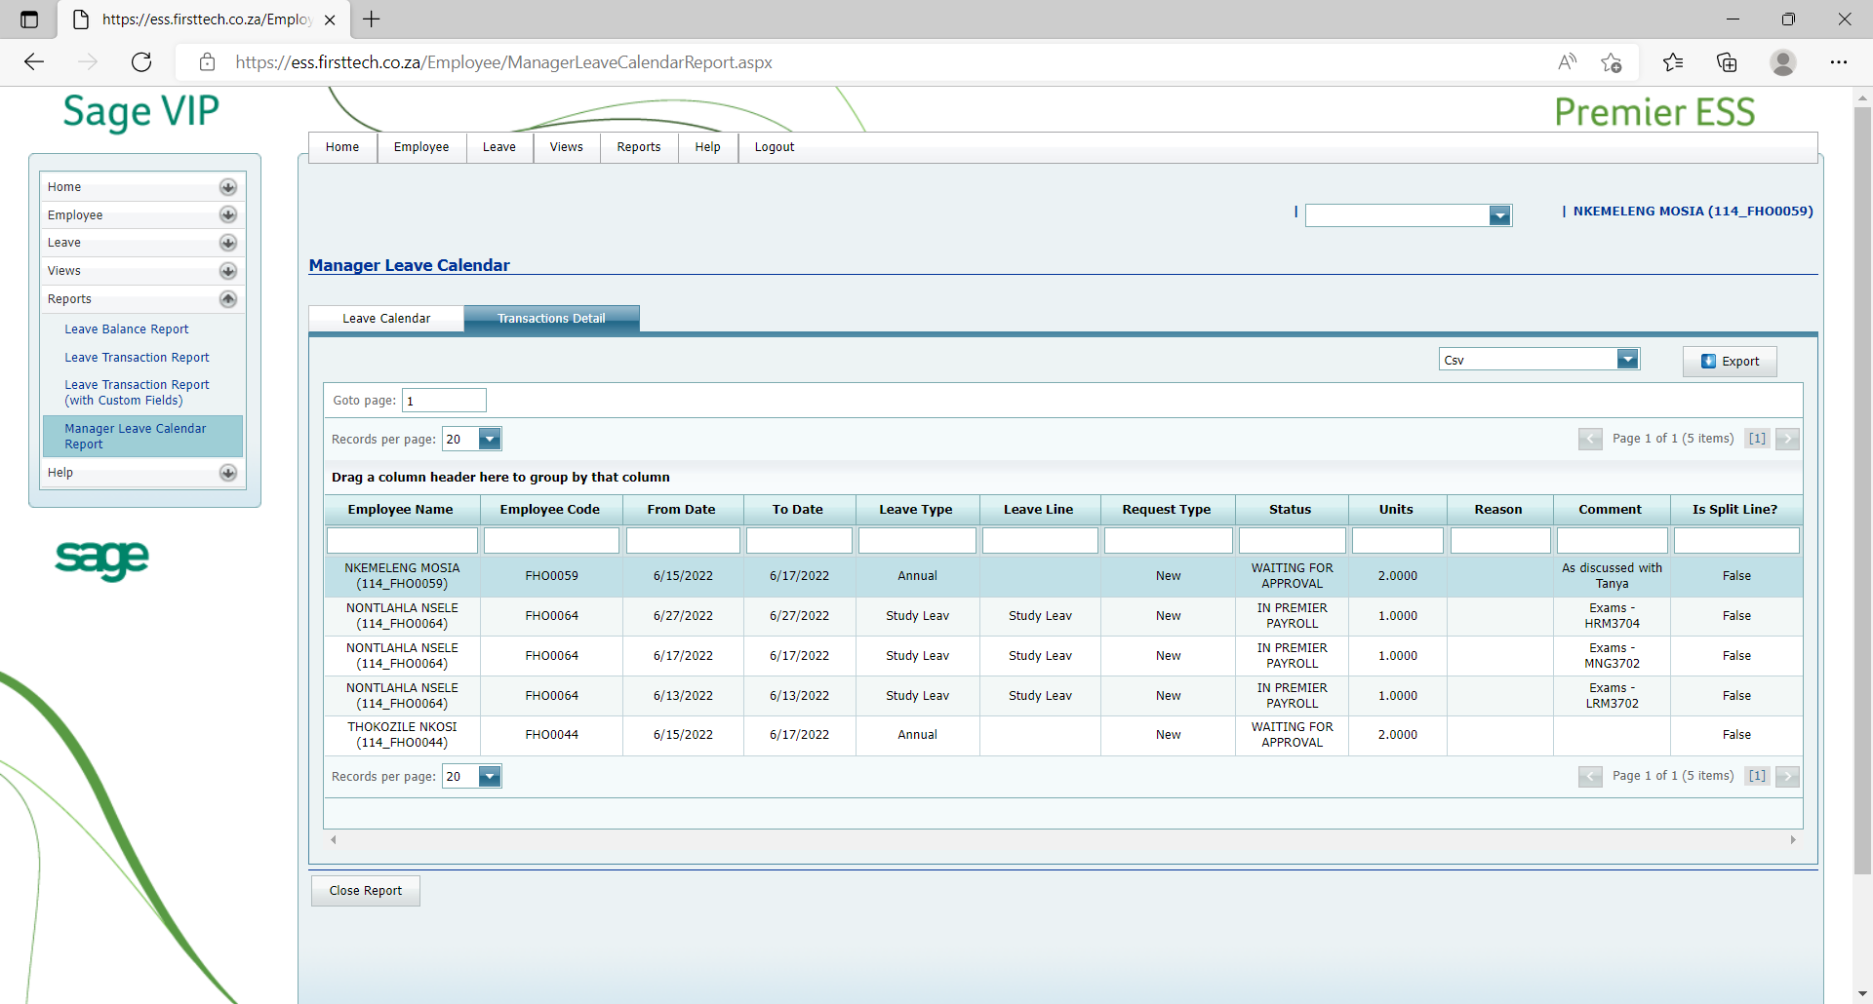
CONTINUE:
MANAGER LEAVE CALENDAR example

Slide 16
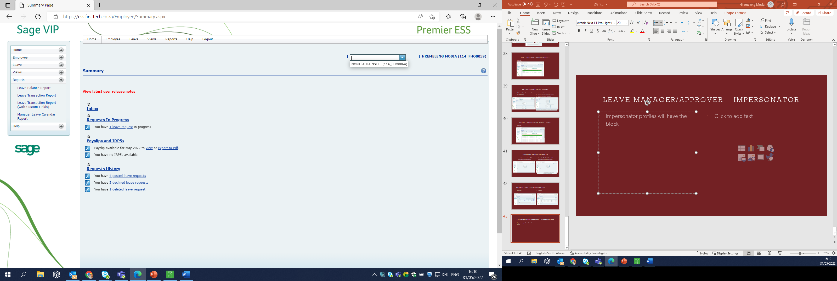
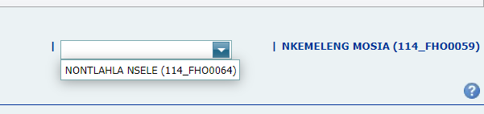
LEAVE MANAGER / APPROVER - IMPERSONATOR
Impersonator profiles will have this block.
Select the employee to personate.

Slide 17
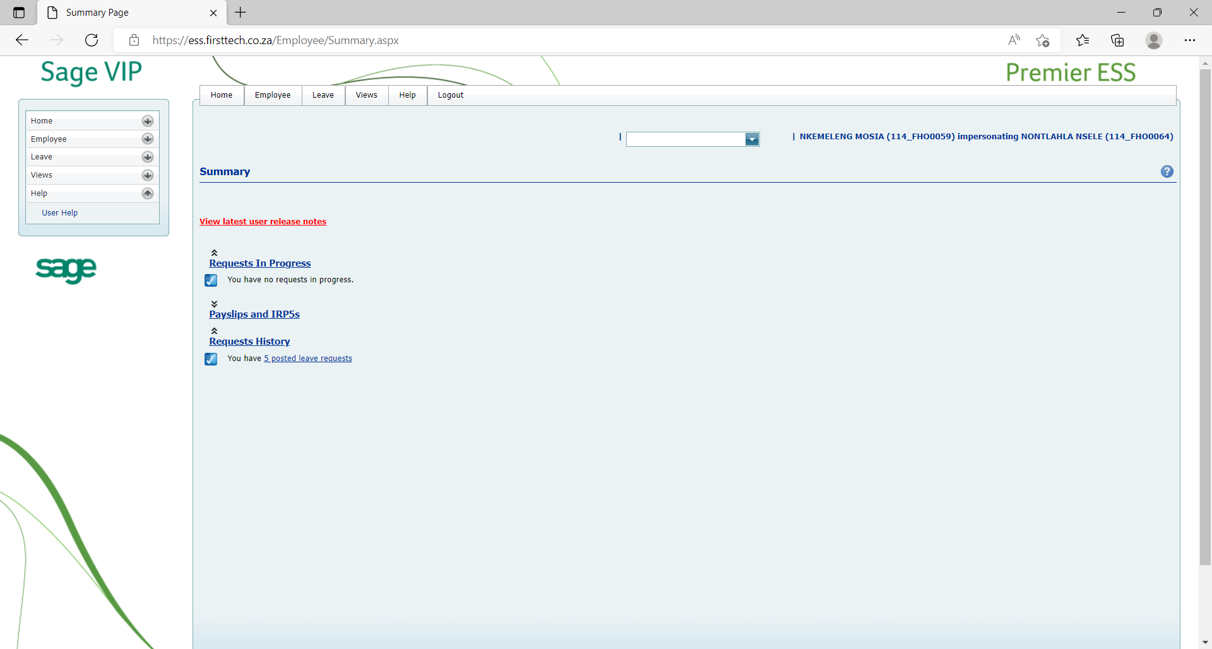
CONTINUE:
LEAVE MANAGER / APPROVER - IMPERSONATOR
Once profile is selected, their profile becomes active for use.
Impersonator has full access to profile.

Slide 18
Thank you

