Slide 1
ESS Manual - EMPLOYEES
How to apply for leave

Slide 2
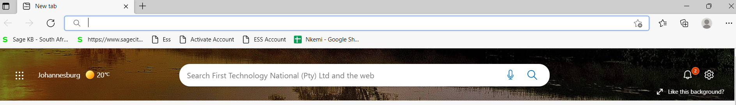
NB: Use the correct URL or ESS address
https://ess.firsttech.co.za/
Do not google the ESS address
Check old ESS emails or email Nkemelengm@firsttech.co.za for assistance or reach out to your Human Resources Payroll Department
Best to save the address on your PC
LOGIN

Slide 3
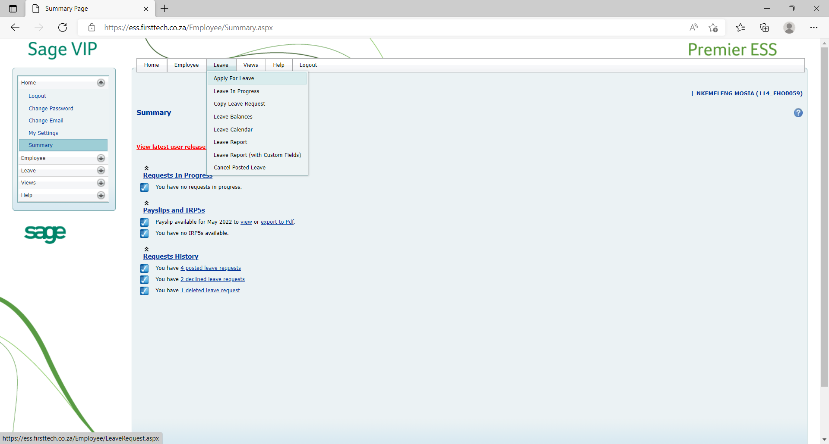
THE LEAVE TAB
Apply for leave
Leave in progress
Leave balances
Leave calendar
Leave report
Cancel posted leave

Slide 4
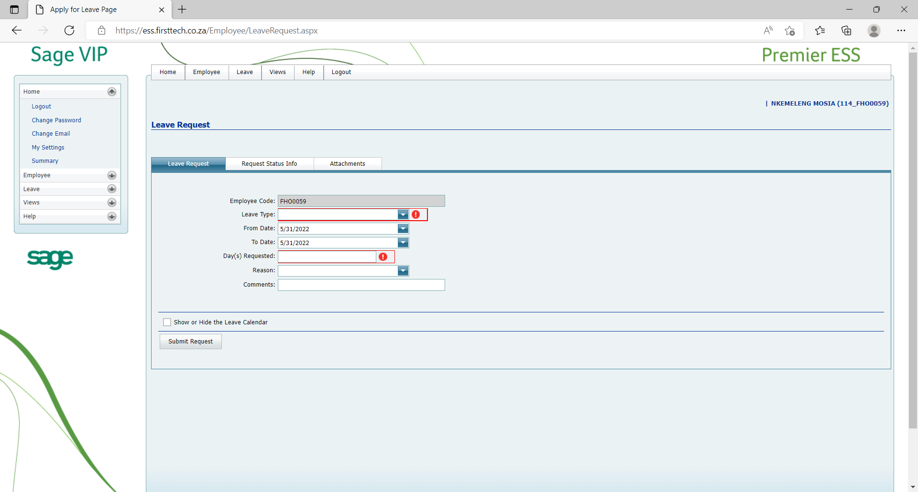
APPLYING FOR LEAVE
Click “Leave” tab
Click “Apply for leave”
Select leave type (drop down)
i.e., Annual, Sick, Study, etc.
Select “from date” and “to date”
“Day(s) Requested” will calculate automatically (excludes public holidays)

Slide 5
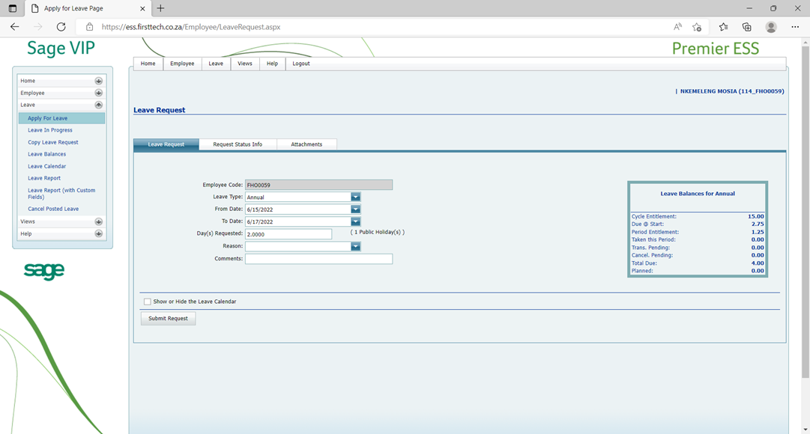
CONTINUE:
APPLYING FOR LEAVE
Ensure that the date and days are correct.
You can add comments if you need to.
NB Check that your leave balance is always positive

Slide 6
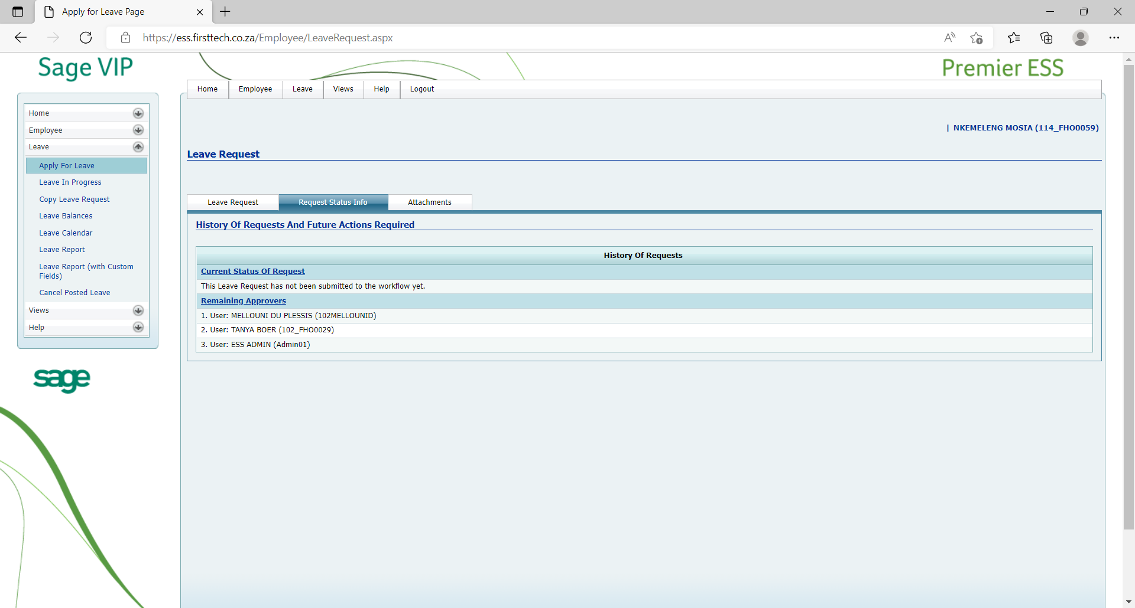
CONTINUE:
APPLYING FOR LEAVE
Click on the “Request Status Info” tab to view your leave approvers.

Slide 7
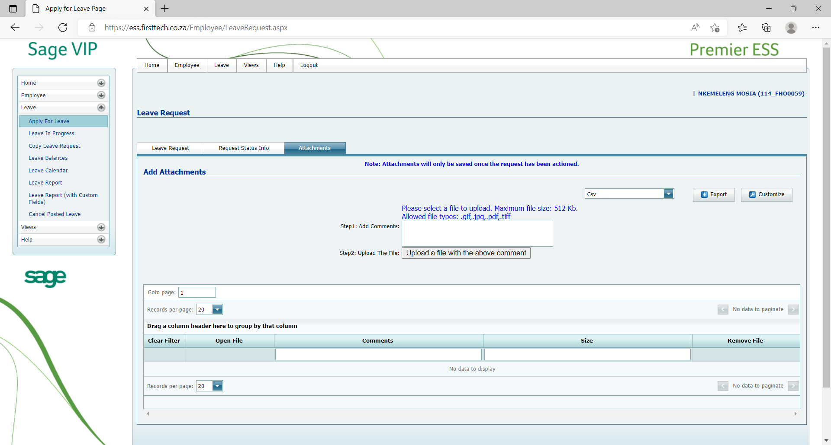
ATTACHING DOCUMENTS
Click on the “Attachments” tab.
Under “Add Attachments” go to “Step 2: Upload the file” two click on.

Slide 8
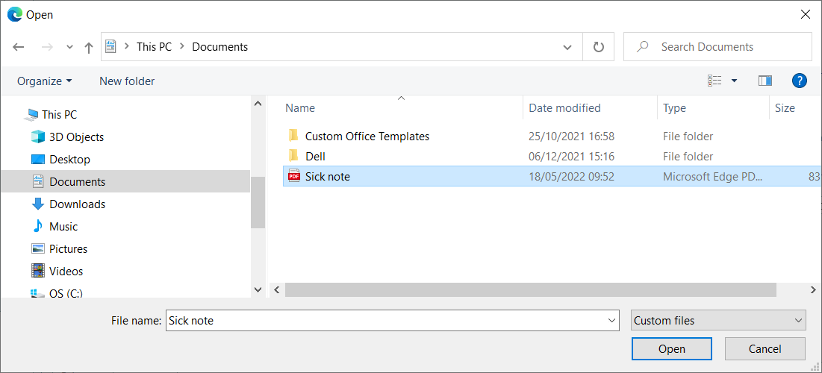
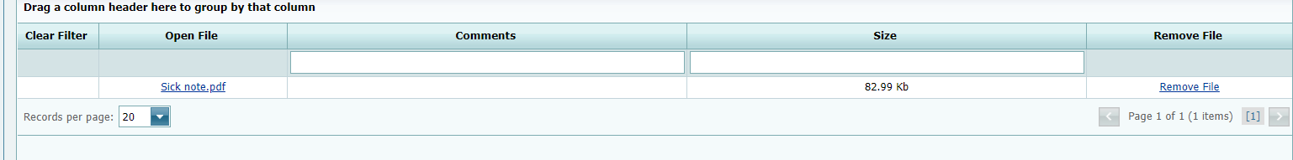
CONTINUE:
ATTACHING DOCUMENTS
Browse to the location of the attachment.
Click on the attachment and select “Open”
If attached correctly it will appear as below:

Slide 9
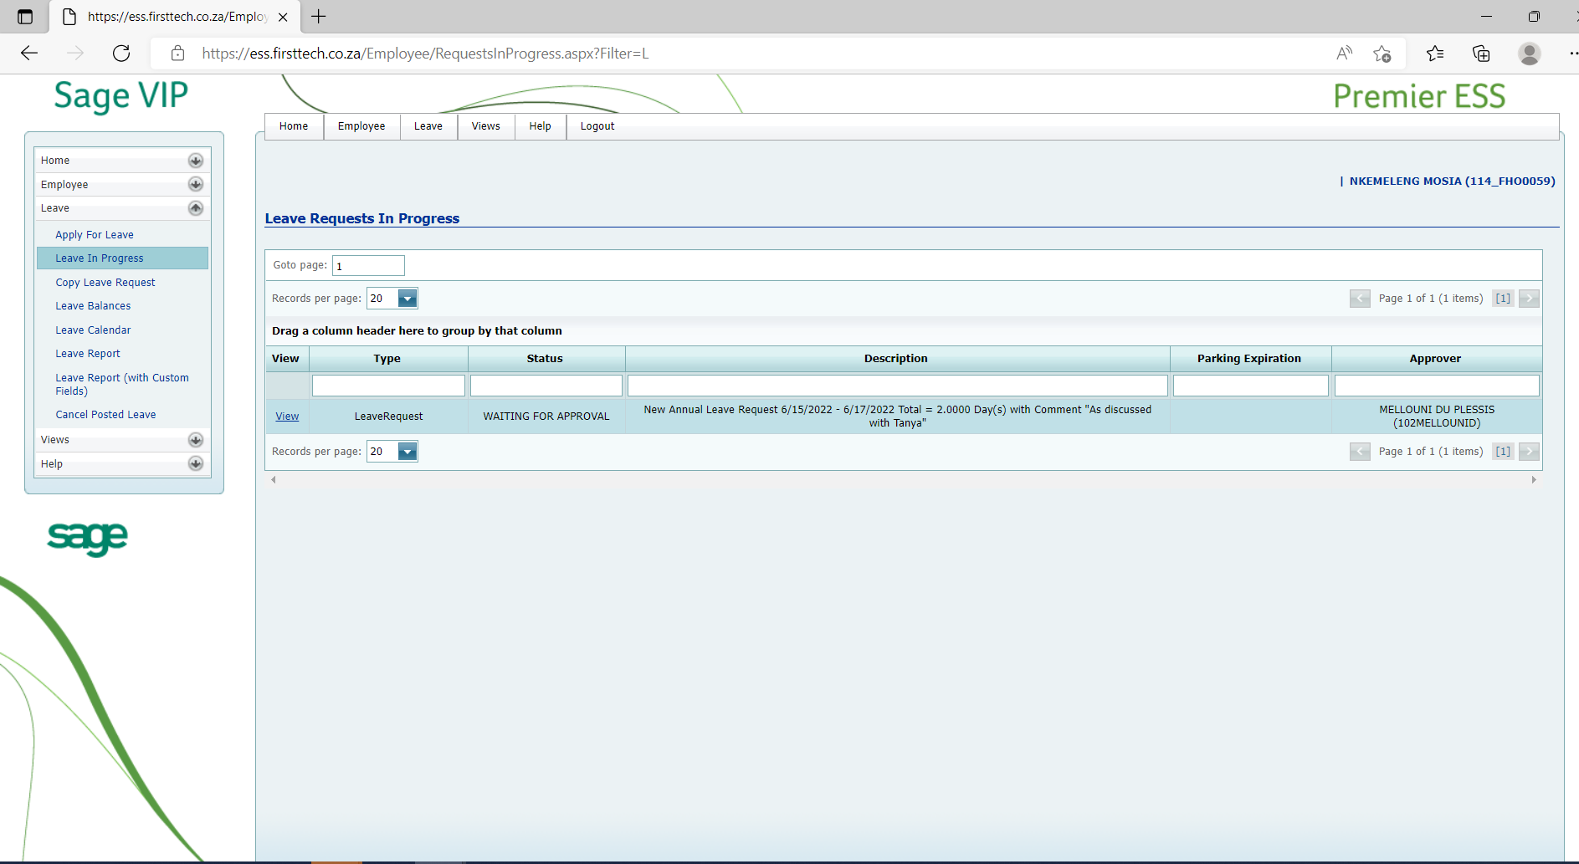
LEAVE IN PROGRESS
All leave in progress will reflect on this screen.

Slide 10
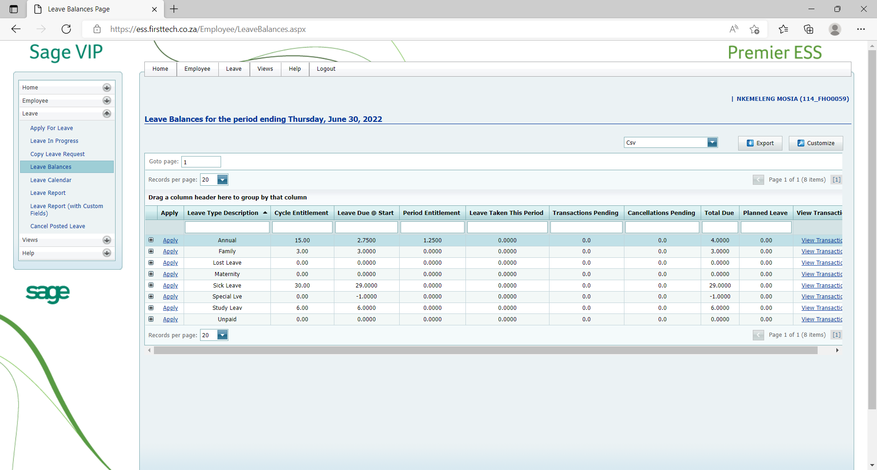
LEAVE BALANCES
“Leave Balances” tab Shows balances for all leave types.

Slide 11
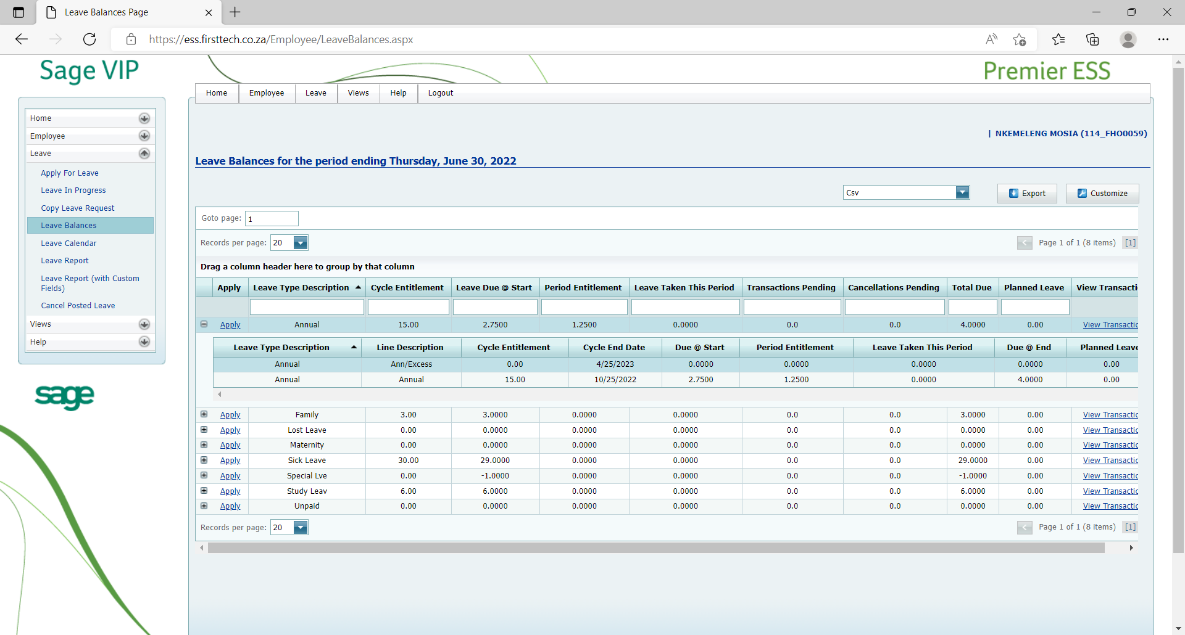
CONTINUE:
LEAVE BALANCES
For Annual leave click on the “+” box to expand and to view your annual or excess leave balance split

Slide 12
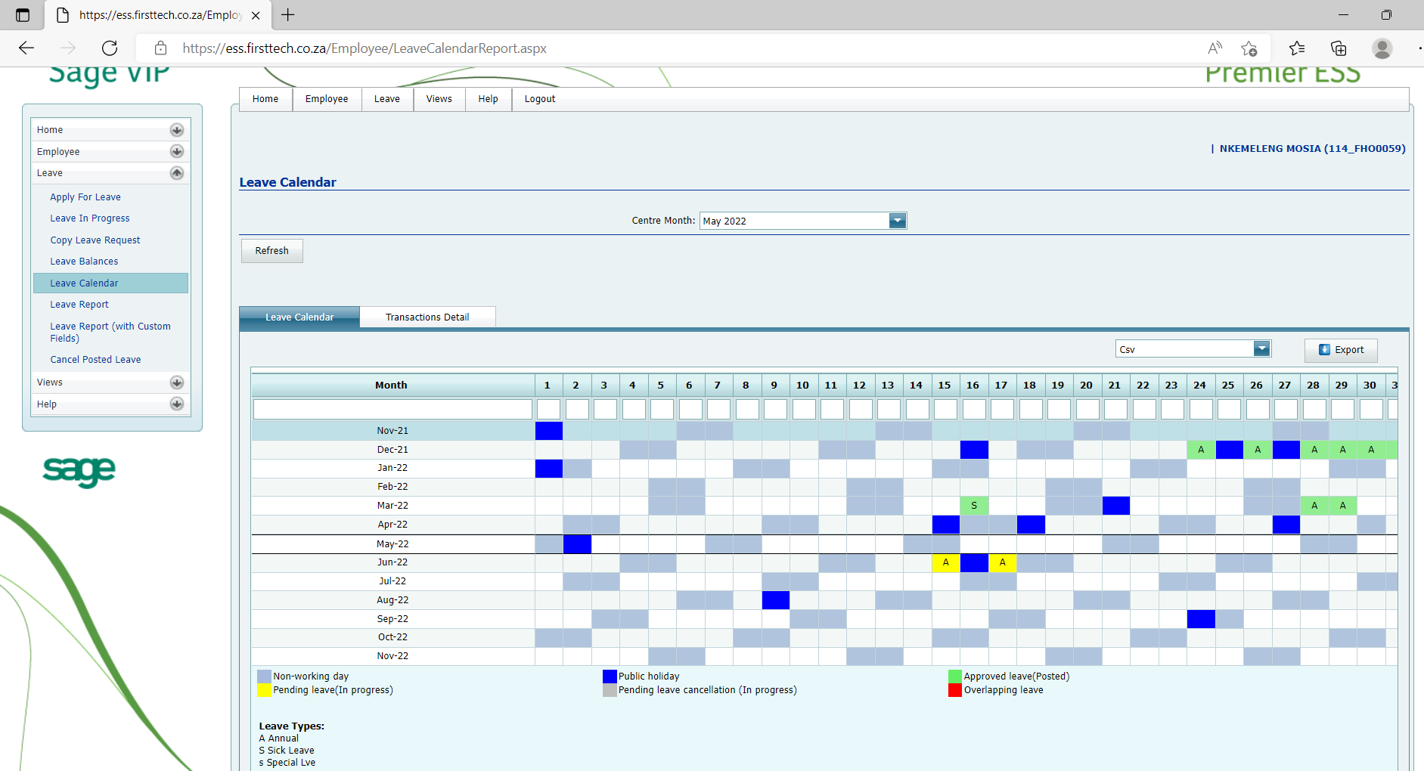
LEAVE CALENDAR
“Leave Calendar” tab shows all the leave transactions as a picture

Slide 13
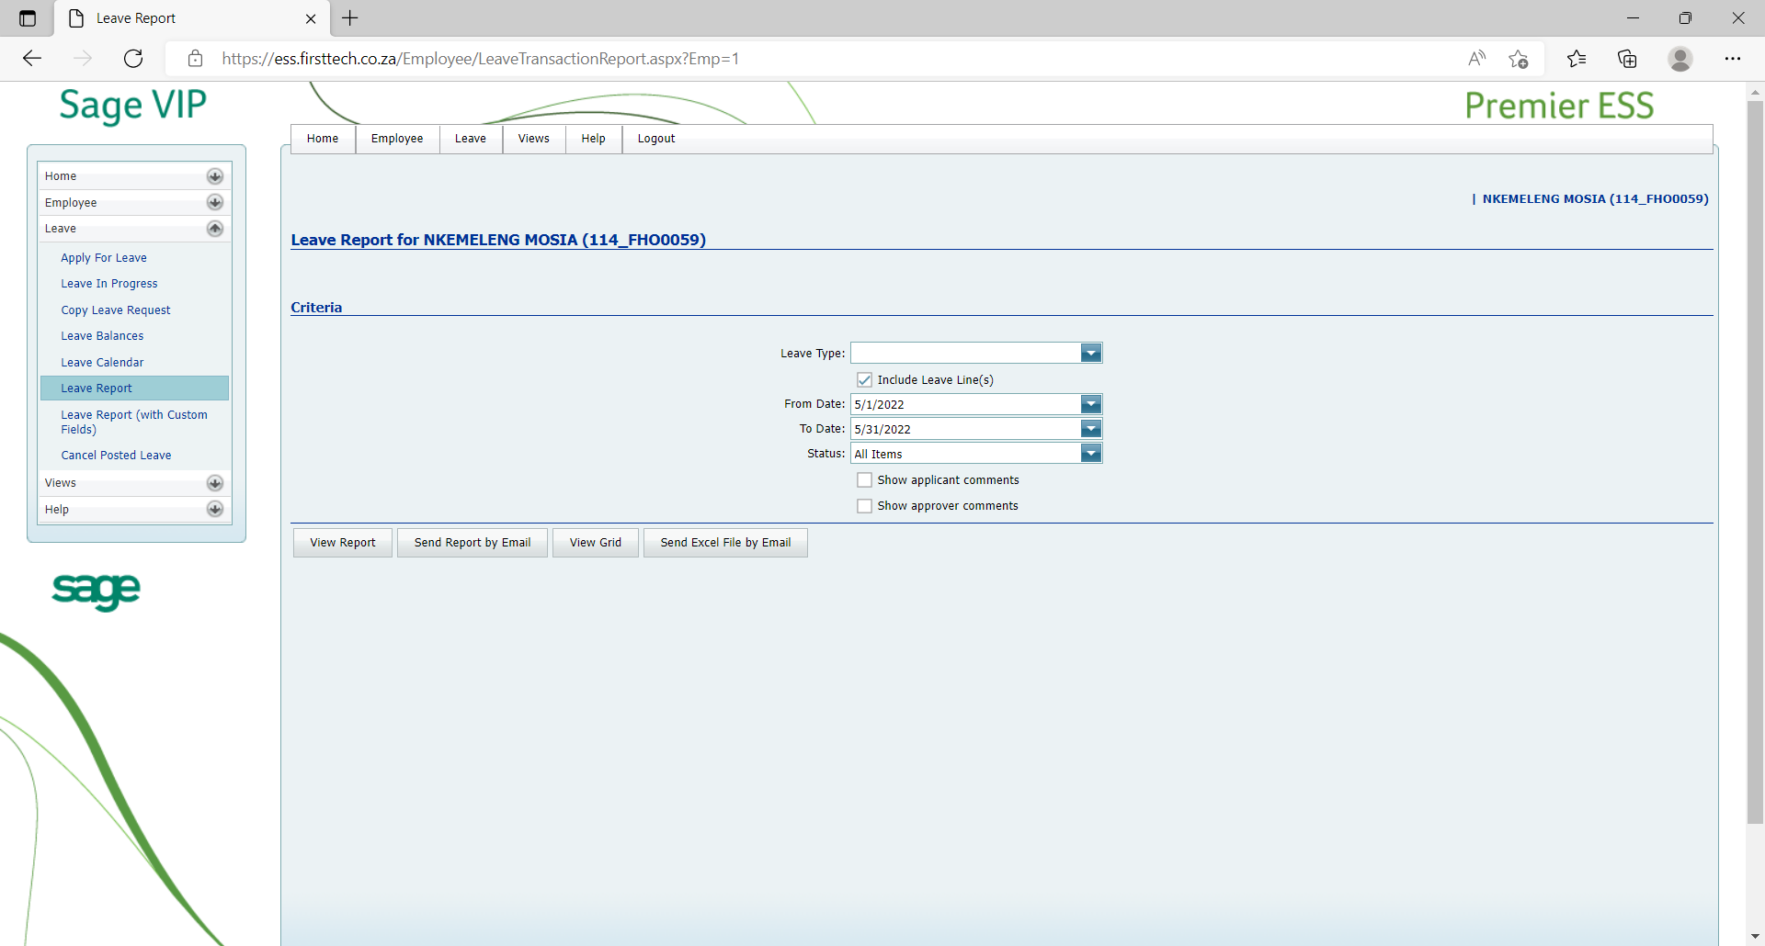
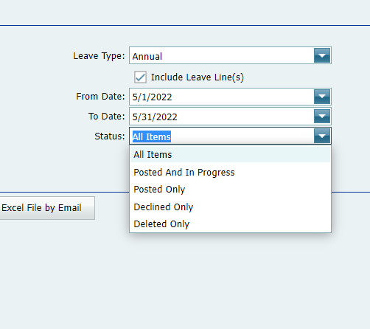
LEAVE REPORT
Under the “Leave Report” tab, it will allow you to print your leave report
You can print the report per leave type.
You have the option to select the period to view.
As well as status such as:

Slide 14
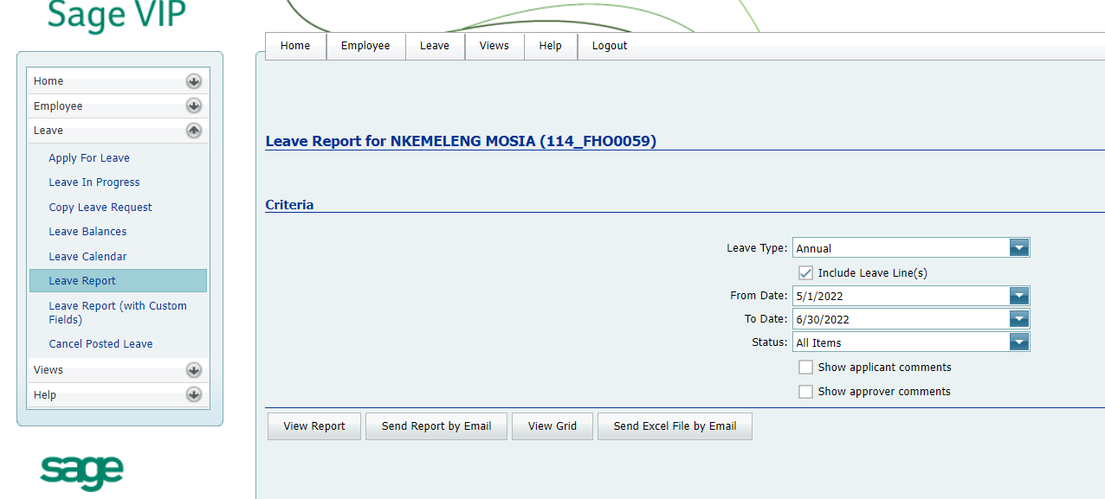
CONTINUE:
LEAVE REPORT
Complete all fields as required
At the bottom of the page. you have the option to view, send by email, send by excel.

Slide 15
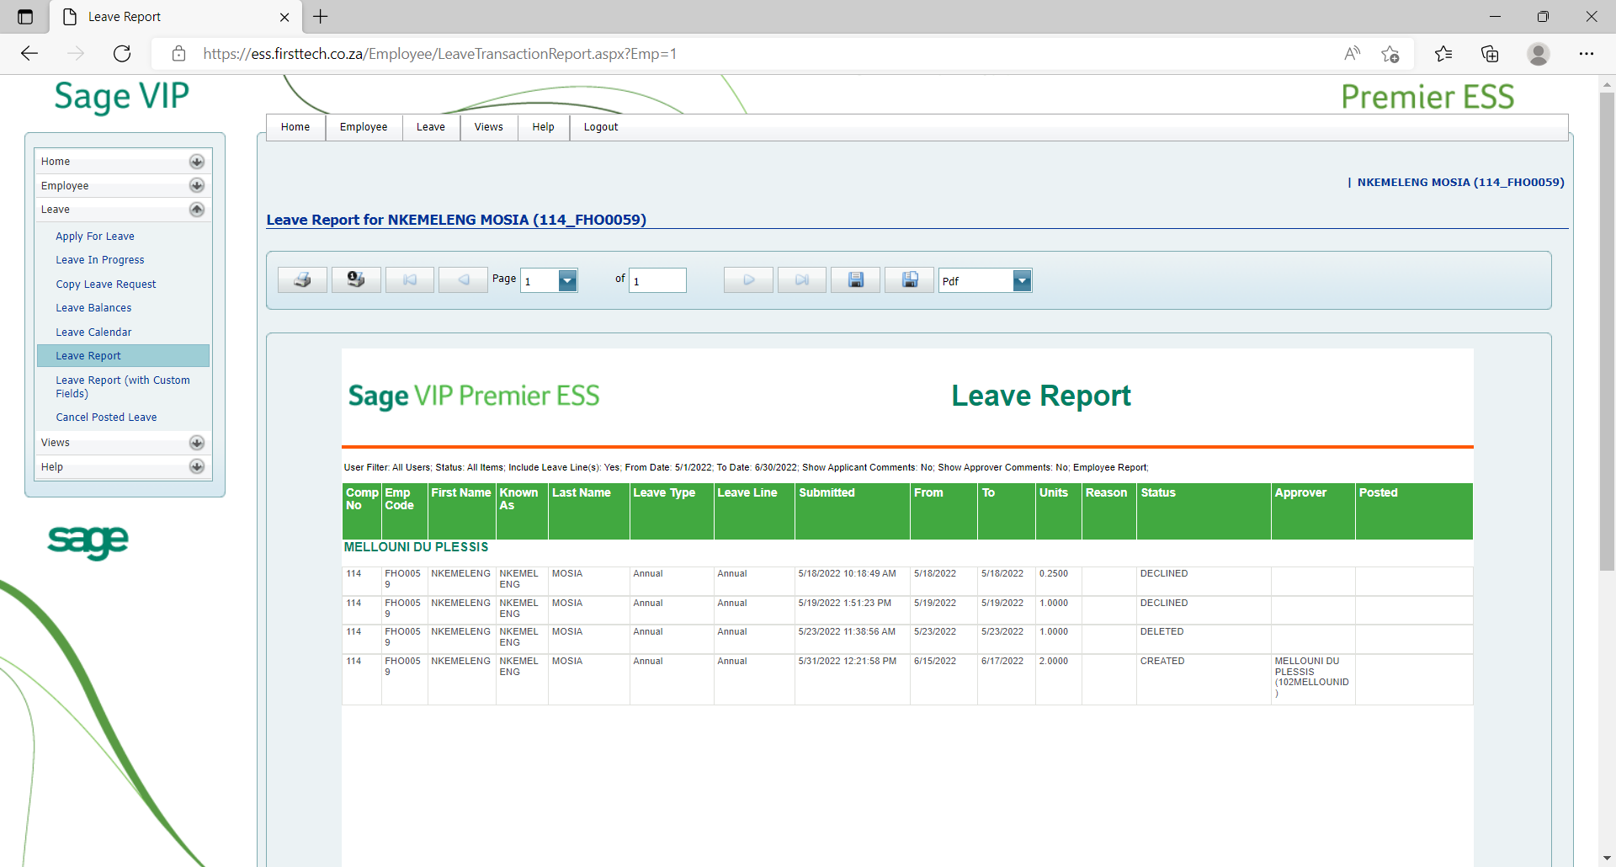
CONTINUE:
LEAVE REPORT
Report will be generated
And can also be printed to pdf or to a normal printer

Slide 16
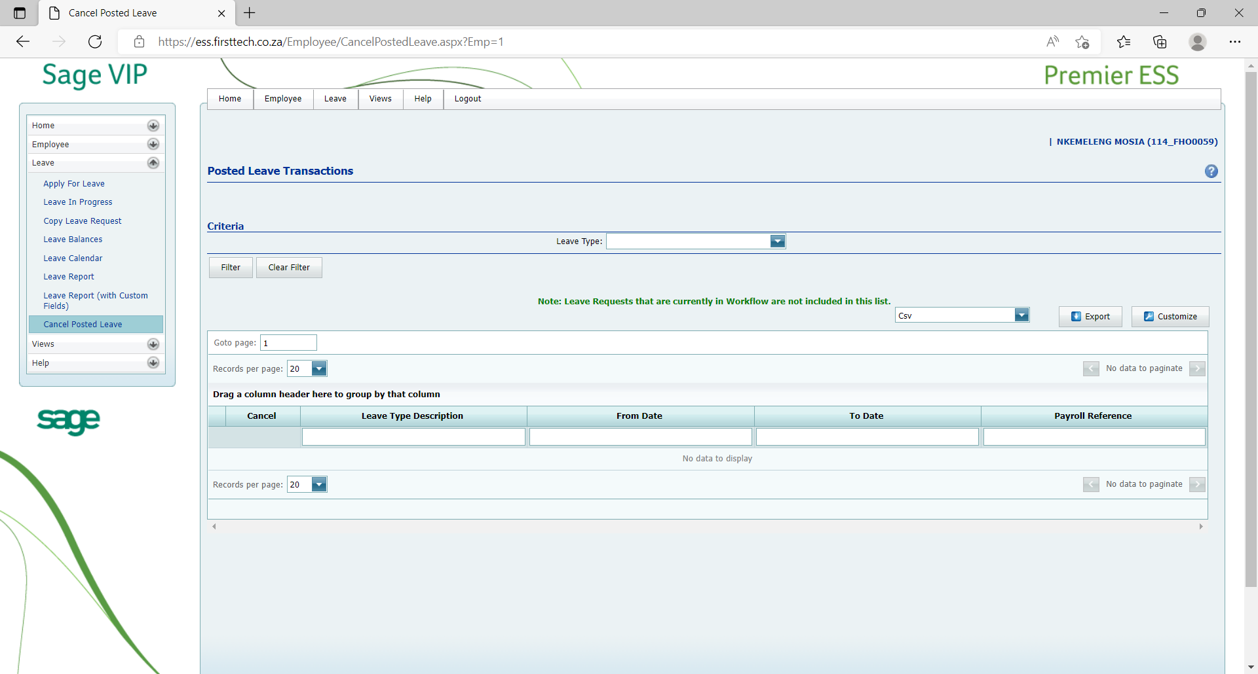
CANCEL POSTED LEAVE
This allows for cancellation of leave that was previously submitted.
The cancellation goes through a similar process as the application.

Slide 17
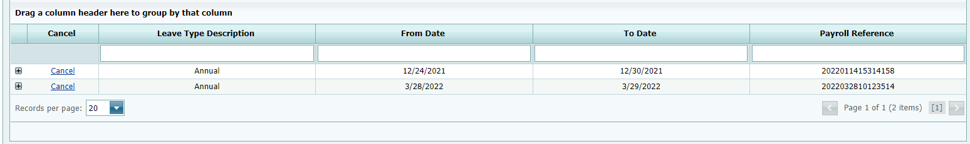
CONTINUE:
CANCEL POSTED LEAVE
Select Leave Type
Click Filter
All posted leave transactions will now appear
Select the one you want to cancel
Click Cancel:

Slide 18
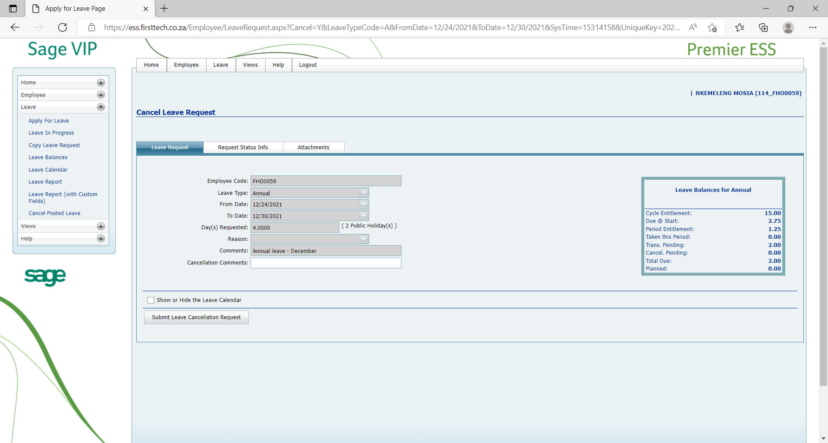
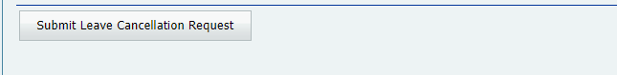
CONTINUE:
CANCEL POSTED LEAVE
“Submit Leave Cancellation Request”

Slide 19
Thank you

